Slide 1











SCORE
NEXUS
Join US Now

Slide 2






ABSTRACT
The project is a desktop-based scoring application developed using Java Swing. It is designed to record and display cricket runs such as sixes, fours, singles, and other scoring events in real time. The application provides an interactive GUI that allows the user to update scores with a single click. This system aims to simplify manual scorekeeping by offering an automated and user-friendly digital solution. Future extensions can include overs, wickets, and player statistics.

Slide 3





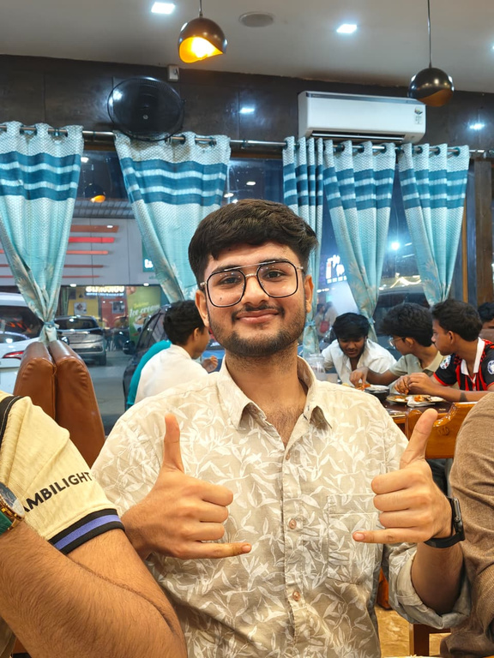

TEAMMATES
ARIJIT MANDAL
SAI PARATE
PARTH CHHABRA
RA2411056010253
RA2411056010288
RA2411056010284

Slide 4




MOTIVATION
Why are you making this project?
Manual scorekeeping is prone to errors.
Digital scoring makes tracking easier.
Simple way to demonstrate Java OOPs + Swing GUI in a practical project.
Can be used in small matches, practice sessions, or learning environments.

Slide 5




Vision
SDG 9 (Industry, Innovation, and Infrastructure): The project uses technology (Java Swing) to provide a digital solution for cricket scoring, replacing manual methods with innovation.
SDG 4 (Quality Education): It helps students learn OOPs and GUI development through a real-world application, making education more practical and skill-oriented.
SDG 3 (Good Health and Well-Being): By supporting sports activities with fair and easy scorekeeping, it encourages participation in physical activities and teamwork.

Slide 6
TECHNOLOGIES USED
Programming Language – Java
• Core Java concepts (OOP, records, collections, file handling)
GUI Framework – Swing & AWT
• Components: JFrame, JPanel, JTabbedPane, JButton, JLabel, etc.
• Used for user interface and navigation.
Database – SQLite (JDBC)
• Stores match data, player stats, and past results.
Data Visualization – JFreeChart
• Manhattan & Worm charts for cricket match progress.
Reporting – iText PDF Library
• Generates professional match summaries and scorecards.
Java Collections Framework
• ArrayList, HashMap, Stack for managing teams, players, and undo/redo.
File Handling & Streams
• Export highlights to CSV and handle match data efficiently.

Slide 7
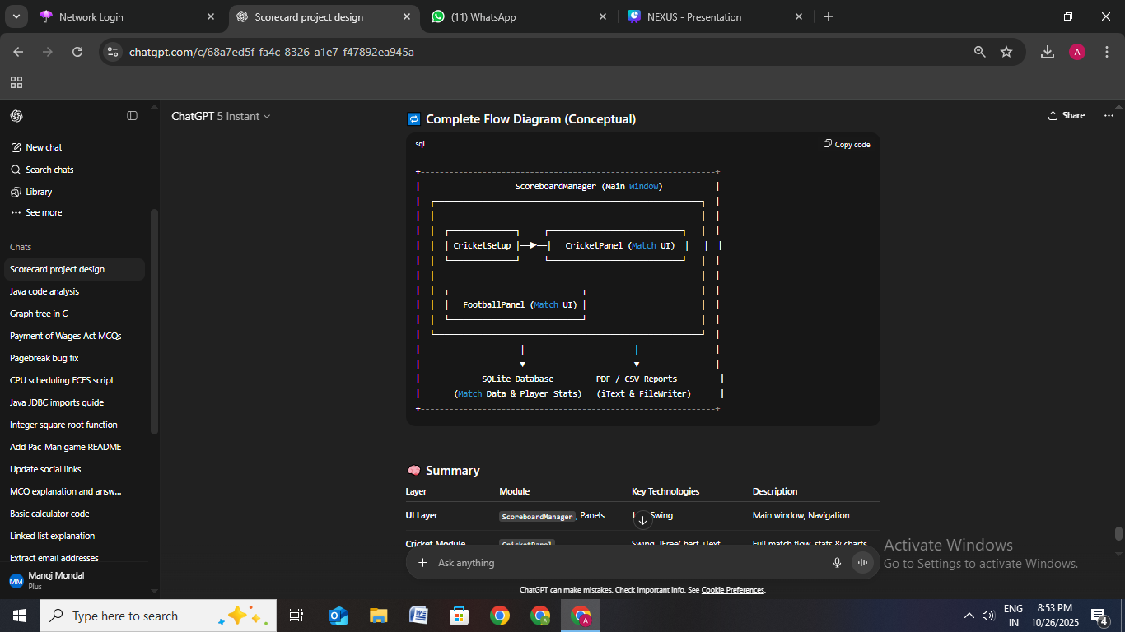
COMPLETE FLOW DIAGRAM

Slide 8
ARCHITECTURE
ScoreboardManager (Main Window)
├── Cricket Module
│ ├── MatchData, MatchState
│ ├── CricketPanel
│ │ ├── Live Scoring (Runs, Wickets, Overs)
│ │ ├── Charts (Manhattan & Worm)
│ │ ├── Undo/Redo System
│ │ └── Highlights Export (CSV)
│ └── PDF Export (iText Report)
│
├── Football Module
│ ├── FootballPanel
│ │ ├── Live Scoreboard (Goals, Fouls, Cards)
│ │ ├── Event Tracking (Goals, Yellow/Red Cards, Substitutions)
│ │ ├── Match Timer & Timeline Display
│ │ └── PDF Summary Generation
│
└── Database Layer (SQLite via JDBC)
├── Match Records Table (Cricket & Football)
├── Player Statistics Table
└── Match History Retrieval

Slide 9




CRICKET MODULE FEATURES
Match Setup: Teams, players, toss, overs, venue
Live Scoring: Runs, wickets, overs, run rate
Charts:
Manhattan Chart – Runs per over
Worm Chart – Cumulative run progress
Player Stats: Runs, balls, 4s, 6s, SR, wickets
Export PDF: Full scoreboard + match summary
Undo/Redo & CSV export

Slide 10
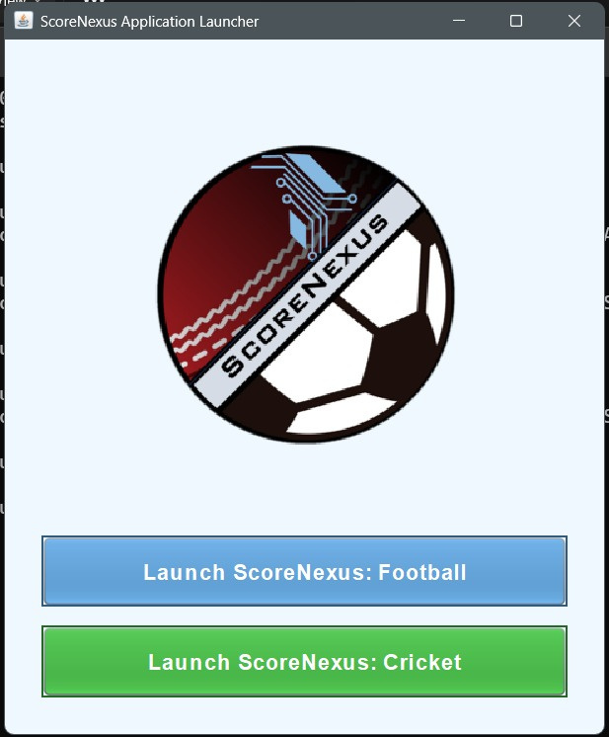
TESTING AND OUTPUT

Slide 11
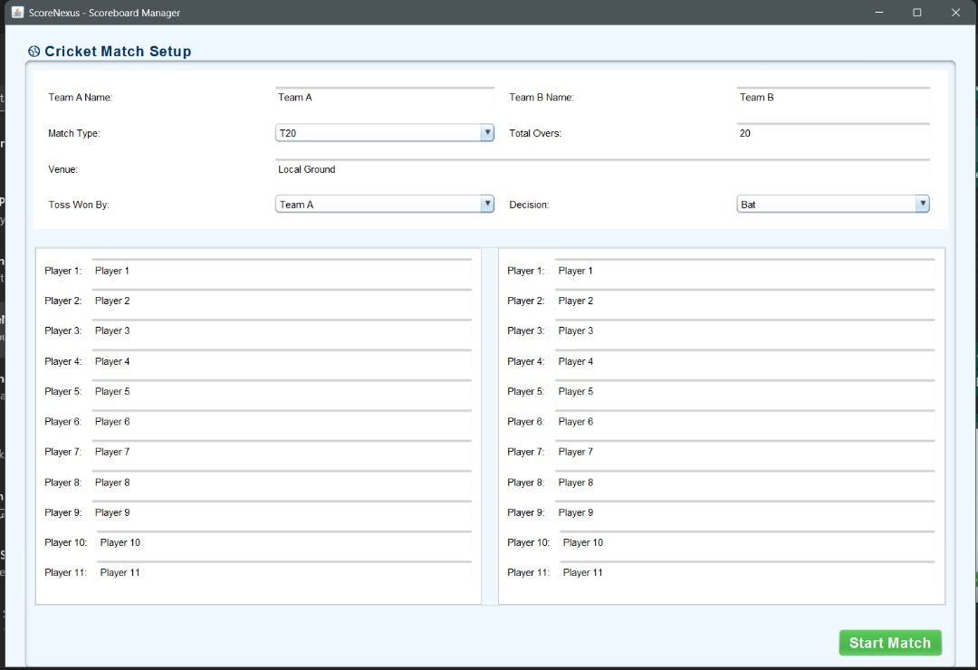
TESTING AND OUTPUT

Slide 12
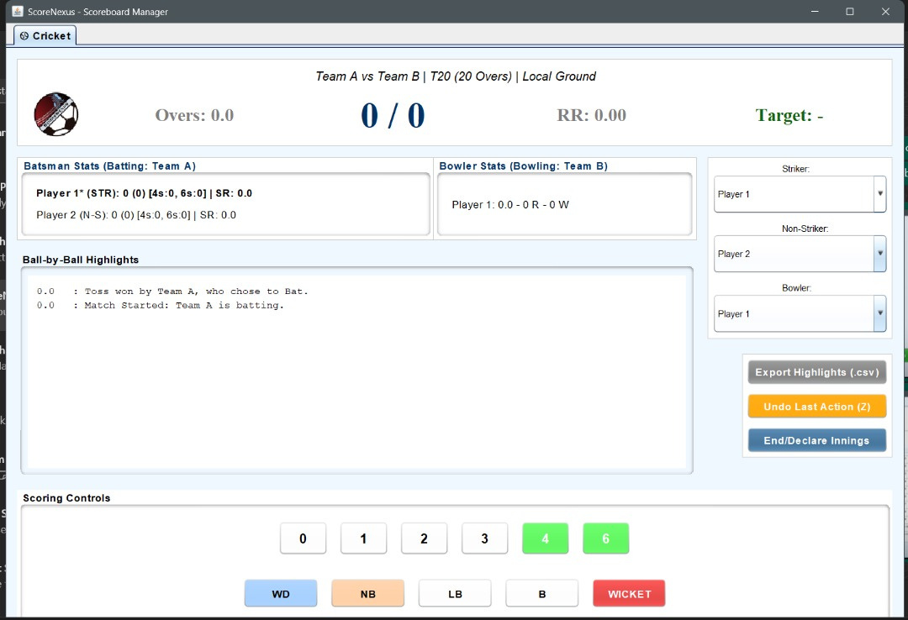
TESTING AND OUTPUT

Slide 13
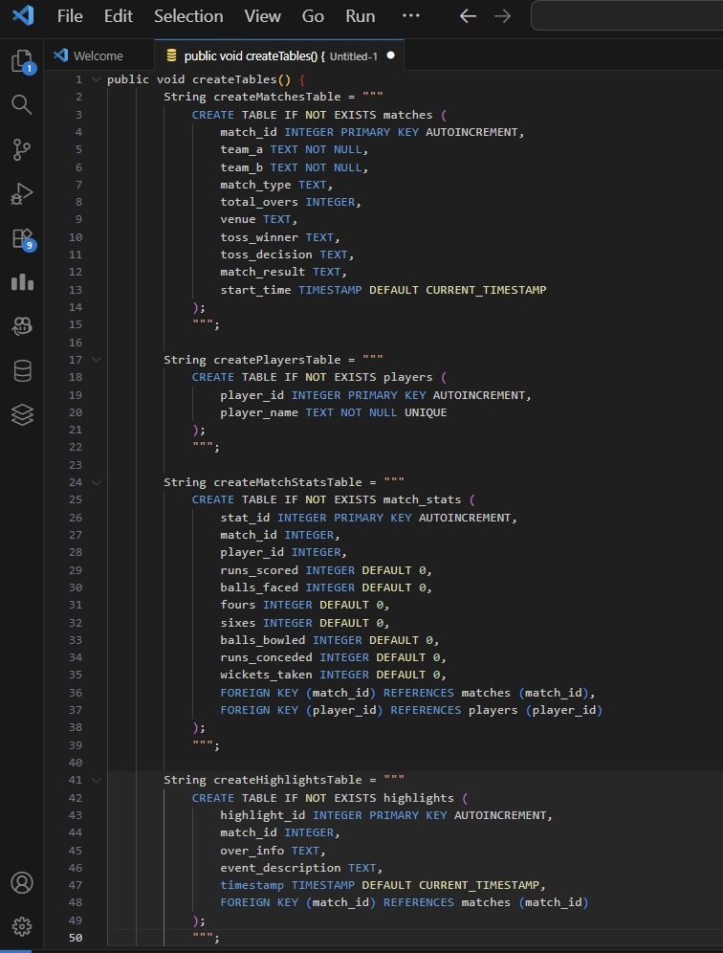
DATABASE INTEGRATION

Slide 14
FOOTBALL MODULE FEATURES
Match Setup: Teams, venue, kickoff time
Live Scoreboard: Goals, fouls, substitutions
Event Tracker:
⚽ Goals (Player, minute)
🟨 Yellow Card / 🟥 Red Card
🔁 Substitution log
Timeline View: Minute-by-minute events
Match Summary: Result, top scorer

Slide 15
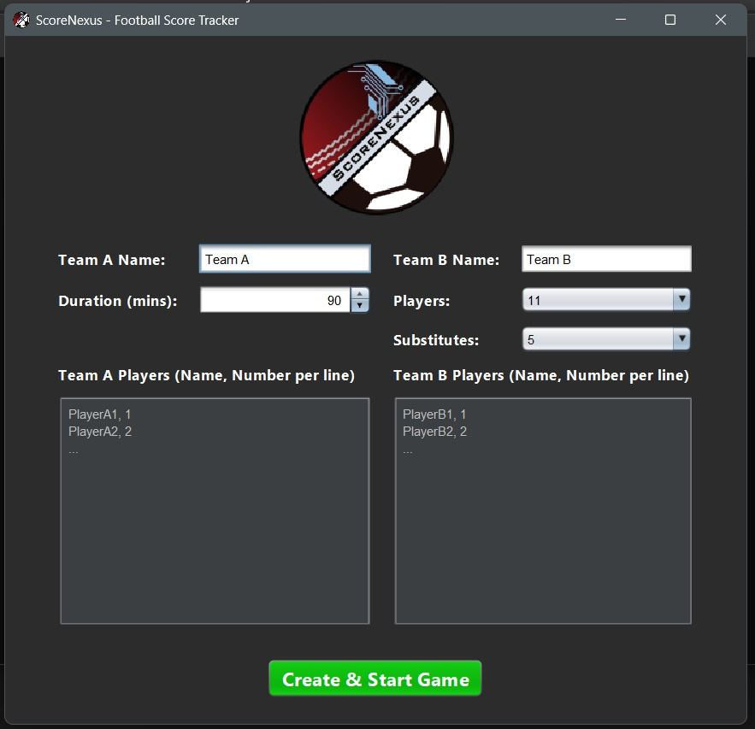
TESTING AND OUTPUT

Slide 16
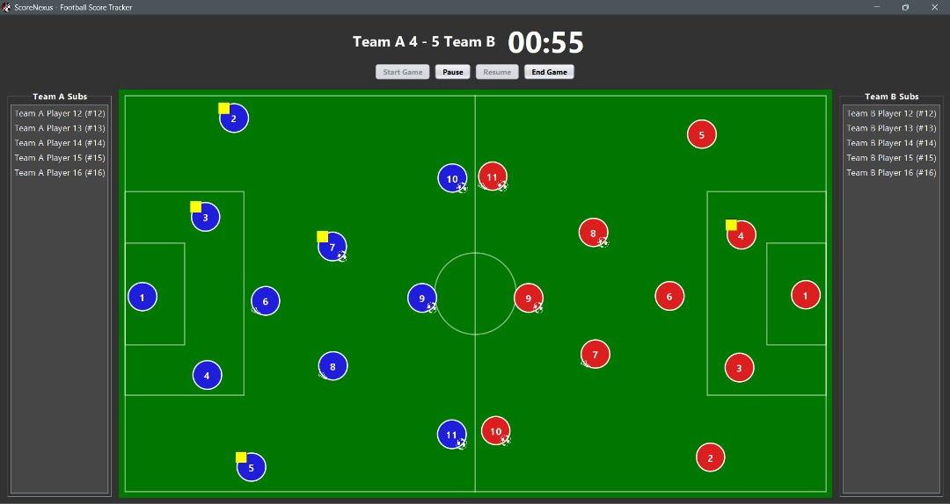
TESTING AND OUTPUT

Slide 17
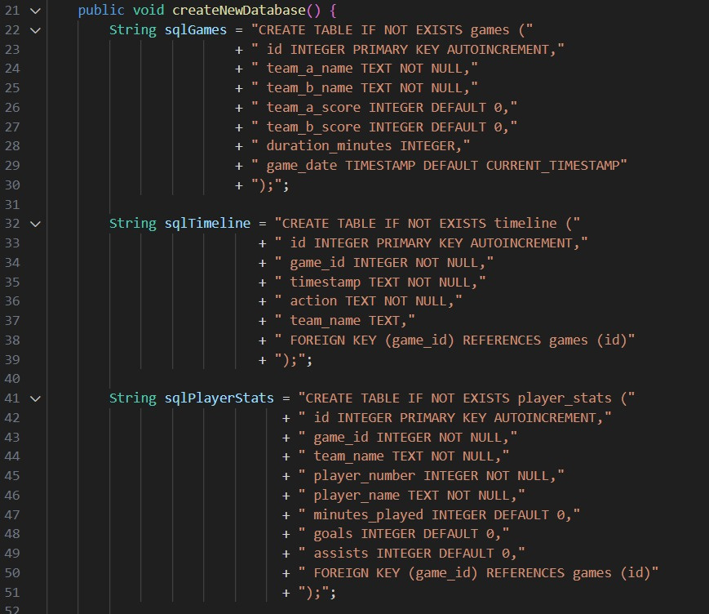
DATABASE INTEGRATION

Slide 18
FUTURE ENHANCEMENTS
AI-Based Performance Insights
Use machine learning to predict player form, best performer, and match outcomes.
Online & Mobile Integration
Add real-time cloud sync and Android app support for live match updates anywhere.
Tournament & Analytics Dashboard
Manage series, generate points tables, and visualize player/team statistics with charts.
Enhanced Reporting & UI
Include logos, charts, and themes in PDF summaries with a modern, interactive interface.

Slide 19
CONCLUSION
Successfully developed a multi-sport scoreboard app.
Applied Object-Oriented Programming, Swing UI, and data persistence concepts.
Enhanced understanding of GUI design and user interaction.

Slide 20
REFERENCES
Oracle Java Documentation
JFreeChart Library Documentation
SQLite JDBC Driver (Xerial)
https://github.com/xerial/sqlite-jdbc
Stack Overflow (Java & UI Solutions)
https://stackoverflow.com/questions/tagged/java-swing
Java Swing Tutorial – GeeksforGeeks
https://www.geeksforgeeks.org/java-swing-tutorial/
SQLite Official Documentation
https://www.sqlite.org/docs.html
JDBC (Java Database Connectivity) Guide – Oracle
Oracle Java Documentation
Stack Overflow (UI solutions)

Slide 21

THANK
YOU

